Slide 1
我的小天地
Day 1
Notes:
Please add learning objectives

Slide 2
While we are going through this text…
You need to fill in columns 3 & 4
3. Guess the pinyin based on what you hear
4. Write the English meaning

Slide 3
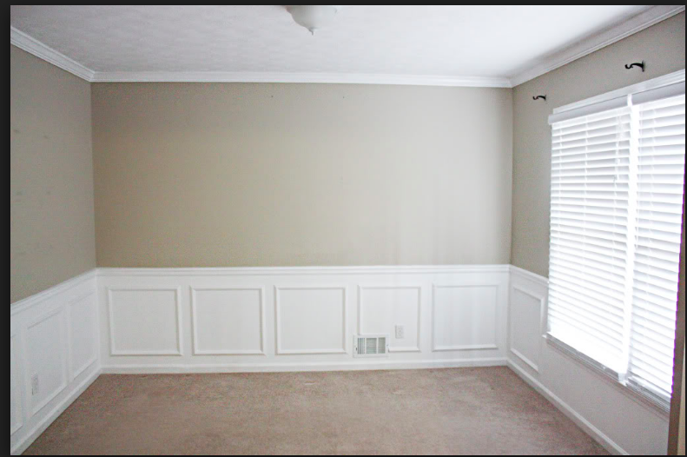
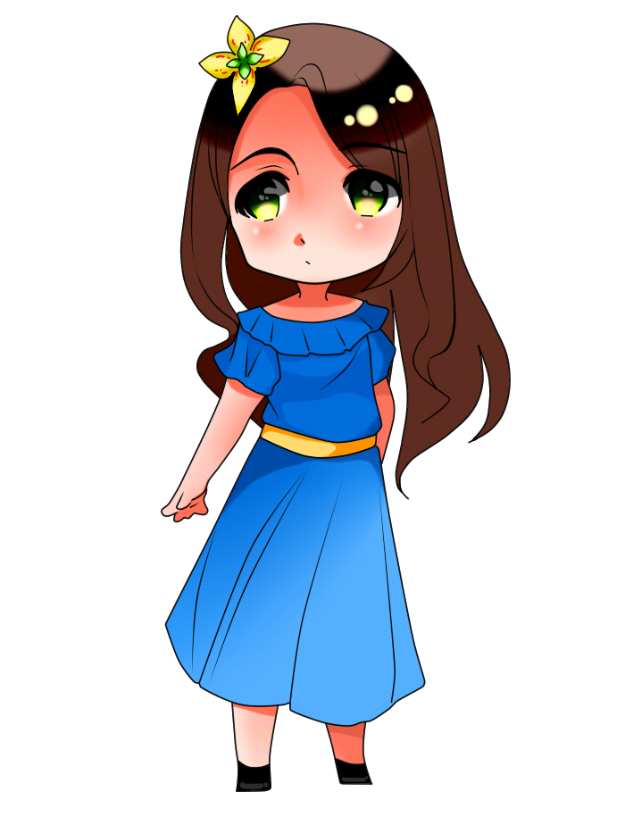
房间

Slide 4
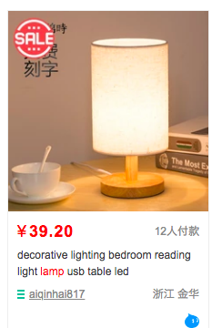
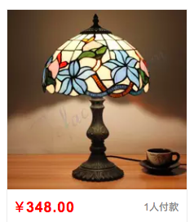
电灯
左边
https://item.taobao.com/item.htm?spm=a230r.1.14.87.164f51959UCxe6&id=568222394108&ns=1&abbucket=18#detail
右边
https://item.taobao.com/item.htm?spm=a230r.1.14.131.164f51959UCxe6&id=558189501938&ns=1&abbucket=18#detail

Slide 5
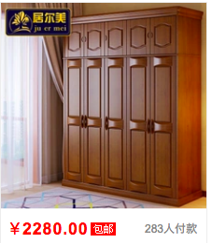
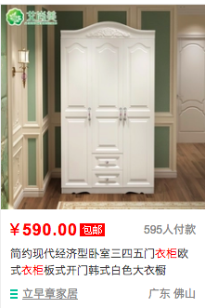
衣柜
左边
右边
https://item.taobao.com/item.htm?spm=a230r.1.14.195.6b512ec3e45dxl&id=550554092925&ns=1&abbucket=18#detail
https://item.taobao.com/item.htm?spm=a230r.1.14.226.6b512ec3e45dxl&id=565658512462&ns=1&abbucket=18#detail

Slide 6
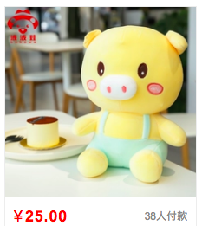
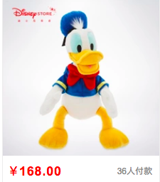
玩具
左边
右边
https://detail.tmall.com/item.htm?spm=a230r.1.14.166.15c46446HQ2wvJ&id=544491604947&ns=1&abbucket=18&skuId=3445498494789
https://detail.tmall.com/item.htm?id=570903603619&ali_refid=a3_430585_1006:1105024226:N:%E7%8E%A9%E5%81%B6%E5%A5%B3%E7%94%9F%20%E5%8F%AF%E7%88%B1%20%E8%B6%85%E8%90%8C:14d89971693e05e5f16553308172f7b1&ali_trackid=1_14d89971693e05e5f16553308172f7b1&spm=a230r.1.14.1

Slide 7
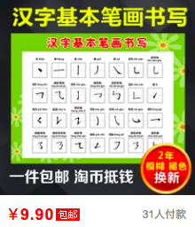
海报
左边
右边
https://item.taobao.com/item.htm?spm=a230r.1.14.48.563759d0xUleQh&id=568015306439&ns=1&abbucket=18#detail
https://item.taobao.com/item.htm?spm=a230r.1.14.188.60c7608eusskCZ&id=550075724783&ns=1&abbucket=18#detail

Slide 8
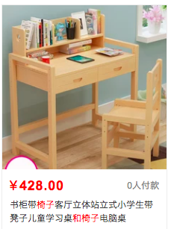
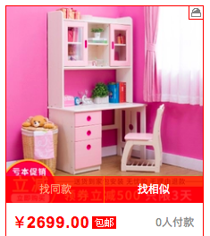
书桌和椅子
左边
右边
https://detail.tmall.com/item.htm?spm=a230r.1.14.64.1f4a57e3SCLfh7&id=569860386862&ns=1&abbucket=18
https://item.taobao.com/item.htm?spm=a230r.1.14.16.326a7d814lpfHJ&id=573663932805&ns=1&abbucket=18#detail

Slide 9
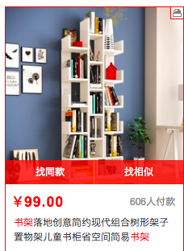
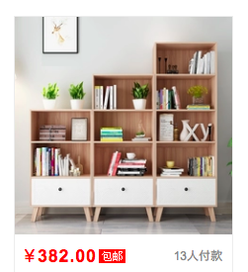
书架
左边
右边
https://item.taobao.com/item.htm?spm=a230r.1.14.32.66b45d8b2FXGDP&id=572258108216&ns=1&abbucket=18#detail
https://detail.tmall.com/item.htm?spm=a230r.1.14.189.66b45d8b2FXGDP&id=573437997283&ns=1&abbucket=18

Slide 10
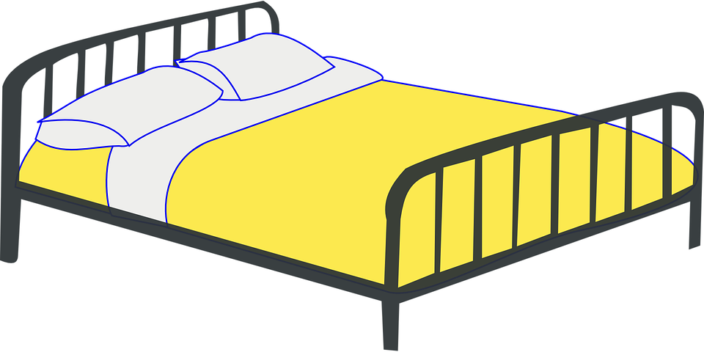
床

Slide 11
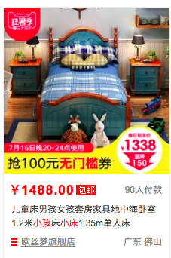
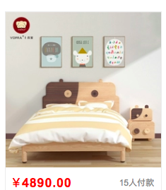
床
左边
右边
≈
https://detail.tmall.com/item.htm?spm=a230r.1.14.243.197c3439T4xlrO&id=564956586393&ns=1&abbucket=18&sku_properties=1627207:3232483;122216712:29217628
https://item.taobao.com/item.htm?spm=a230r.1.14.32.66b45d8b2FXGDP&id=572258108216&ns=1&abbucket=18#detail

Slide 13
电视

Slide 14
电视

Slide 15
上面
左边
左边
书架
上面
右边
右边
左边

Slide 16
tonight’s homework:
Practice vocabulary using Quizlet
We will have a vocabulary quiz first thing on Day 2.

